Slide 1
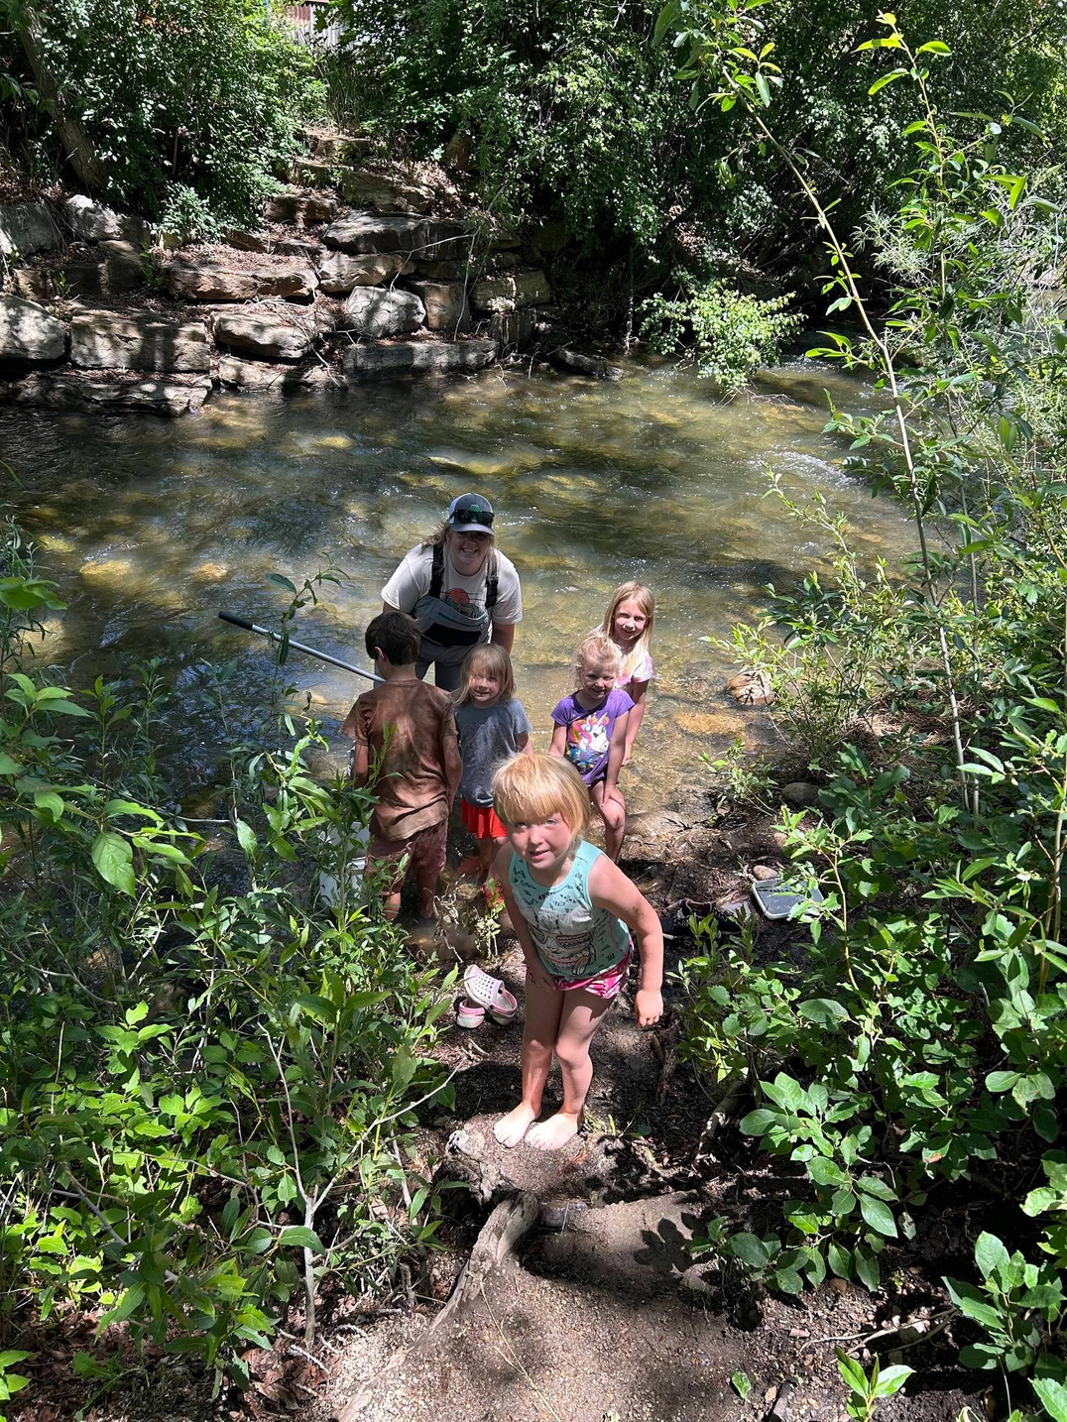
Mancos Conservation District
Youth Education Program
Presented To
NCDEA
Presented By
Taylor Schultz & Sensa Wolcott

Slide 2
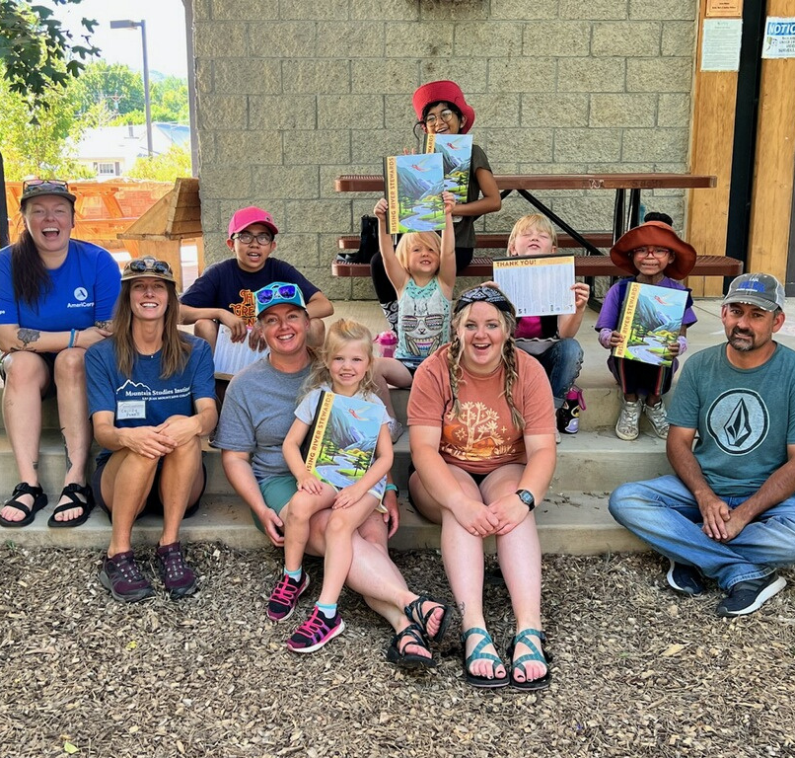
Hello!
Taylor Schultz
Education & Outreach Coordinator
Sensa Wolcott
Watershed Coordinator

Slide 3
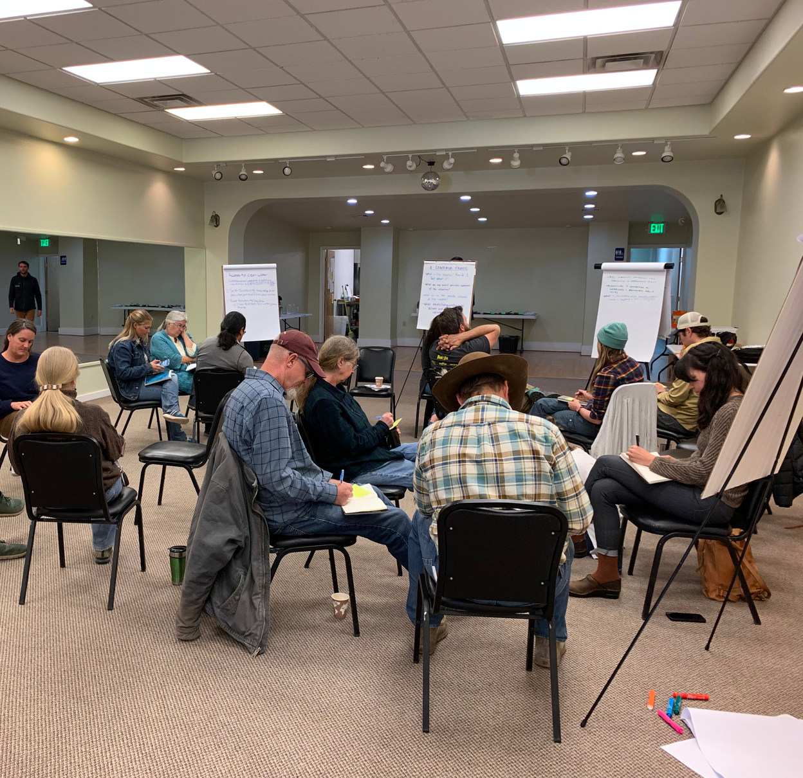
Education @ MCD
Strong Focus on Education Historically
Adult education & resources
Workshops, Master Land Steward Program
Montezuma School to Farm Project
Branched off in 2020
Continued Desire for Education
Community expressed need at feedback events related to the Mancos Watershed Stream Management Plan

Slide 4
High School Chemistry Lessons
MCD facilitates water sample collection and analysis with local high school students as part of the Colorado River Watch program
Introductory lesson - background and training
Samples collected and analyzed 1x per month
Makes learning relevant to real life
Gets kids outside
Teaches valuable lab skills

Slide 5
Mancos Public Library Lessons
River Literacy Program
MCD team members teach about a variety of natural resource topics, all related to water and our connection to the Mancos River.
Teach 1-hour lessons every other Friday
Topics include:
Water quality
Macroinvertebrates
Clouds
Snow
Beavers
Adaptations
Water cycle

Slide 7
CACD Poster Contest
MCD works with the Mancos Elementary Art Teacher and Mancos 5th graders to create art posters for the Colorado Association of Conservation Districts’ (CACD) Annual Poster Contest.
Each year, MCD staff teaches natural resource lessons relating to the topic and aids students in finding resources to create posters. Students spend several weeks creating posters that the community then votes on them at the Mancos Public Library.

Slide 8
Field Trips
MCD offers field trips to discuss the district's programming and get students interested in natural resources.
The most important aspect is getting students involved with hands-on science and making connections from the classroom to real world applications.

Slide 9
MCD’s Capacity for Education
AmeriCorps Vista and AmeriCorps Members
District Conservation Technicians
Funding through NRCS’s Education and Outreach Grant allowed for MCD to hire a full-time Education and Outreach Coordinator.

Slide 10
How do we fund it?
MCD’s education and outreach programs are possible through
Grant funding
Partnerships

Slide 11
Community Partnerships

Slide 12
Lessons Learned
Tie lessons into curriculum
State/National education standards
Classroom management is vital
Adapt & be flexible
Over plan, but be prepared to cut it short
Don’t reinvent the wheel

Slide 13
Resource Page

Slide 14
Our Contact Information
Taylor Schultz - Education & Outreach Coordinator
taylor@mancoscd.org
970-739-3137
Sensa Wolcott - Watershed Coordinator
sensa@mancoscd.org
970-394-5292

Slide 15
THANK YOU!

